Slide 1

Python Fundamentals
Bangladesh-Bharot Digital service for employment & training (BDSET)

Slide 2
Introduction to Python
What is Python?
A high-level, versatile programming language
Designed for simplicity and readability, making it beginner-friendly
Created by Guido van Rossum and first released in 1991
General Purpose Language and Multi Paradigm Language

Slide 3
Introduction to Python
What is Python?
Versatile Language
Applicability Across Domains
Cross-Platform Support
Multi-Paradigm Support
Extensive Libraries and Frameworks
Scalability

Slide 4
Introduction to Python
What is Python?
General Purpose Language and Multi Paradigm Language
Scientific Computing (NumPy, SciPy)
Embedded Systems (Micro Py for IoT)
Web (Django, Flask)
ML and DL (Pandas, TensorFlow)
Game (PyGame)
Automation and Scripting (For Repeating tasks)

Slide 5
Introduction to Python
What is Python?
General Purpose Language and Multi Paradigm Language
Procedural Programming
OOP
Functional Programming

Slide 6
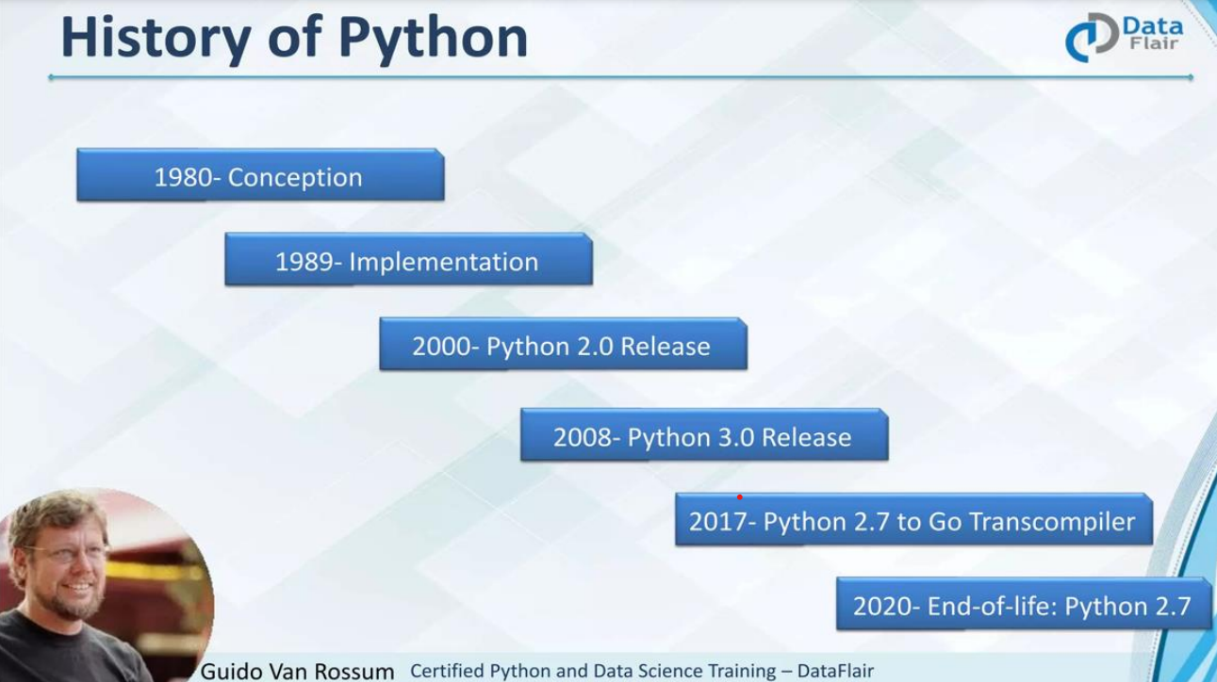
Introduction to Python

Slide 7
Introduction to Python
Why Python?
Ease to Learn
Intuitive syntax close to plain English
Fewer lines of code compared to other languages.
Strong Community Support
Thousands of libraries and frameworks available
Active community for learning and troubleshooting

Slide 8
Introduction to Python
Why Python?
More Remarkable Features
Interpreted (Execute Line by Line)
Dynamically Typed (No Declaration)
Open Source
Platform Independent
Intensive Library

Slide 9
Data Types and Variables
Variables
Container (Contains values, hold storage)
Can be modified
Naming Rules
Declaration and Assign
Scope of Variables (Local and Global)

Slide 10
Data Types and Variables
Data Type
Type of data will be assigned to variable
Python is Dynamic (No declaration needed)
Multiple Assign
Primitive Data Types
Composite Data Types (Non-Primitive)

Slide 11
Data Types and Variables
Data Type
Numeric Data Type (int, float, complex)
Composite Type (String, Tuple, Array, Object)
Dictionary
Boolean
Set
List
Map

Slide 12
Data Types and Variables
Data Type
Concatenation
Type Casting

Slide 13

Any Question?

Slide 14
Thank you
Md. Shawal Hasan Hridoy
Shawalhasan.bdset@gmail.com
Contact: 01517168376

